Slide 1
ML Python Toolkit
UCSB Presentation

Slide 2
Python

Slide 3
Anaconda Installation
Install Anaconda: https://conda.io/docs/user-guide/install/index.html

Slide 4
Virtual Environment
A self-contained directory tree that contains a Python installation for a particular version of Python, plus a number of additional packages
Venv - https://docs.python.org/3/tutorial/venv.html Also Install Virtual Environment Wrapper - https://realpython.com/python-virtual-environments-a-primer/
Notes:
which python outside and inside

Slide 5
Virtual Environment - Conda
Conda command - conda create --name <virtualenv name> python=<version>
Example: conda create --name 3point6 python=3.6
Conda: https://conda.io/docs/user-guide/tasks/manage-environments.html

Slide 6
Flask

Slide 7
Flask - A micro framework for Python
built-in development server and debugger
integrated unit testing support
Notes:
Framework - resuable code In simple words, a framework is anything that helps you complete your work faster. For example, if I were to tell you to create a python server that could host a website; you would be able to do it in just under 120 lines of python code using several libraries for tasks such as, mapping a function to a route(url), writing socket functions for protocols and finally displaying that one webpage. You will have to repeat all of this for every webpage in the website. Not to forget the overhead of actually interpreting and typing all the lines of code. Frameworks abstract all the above lower level tasks and helps you focus on the actual application. Clearly Flask doesn’t restrict itself to being a backend service, but instead stages, hosts and handles your complete web application

Slide 8
Installation
pip install flask
or
conda install flask

Slide 9
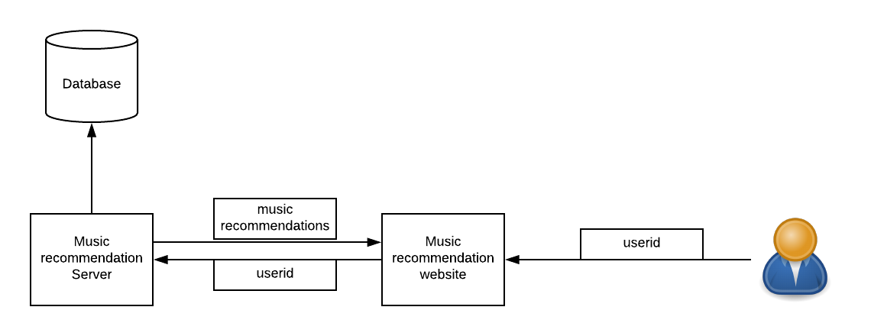
Example Architecture

Slide 10
GET vs POST
POST
Create, Update, Delete operations
No size limit
GET
Safe and idempotent
Sent in the URL
Size limit

Slide 11
Jupyter Notebooks
create and share documents that contain live code, equations, visualizations and narrative text

